Slide 1
L6 Group-1 Pitch 3
Caitlin White, Connor Wilby, Jamie Chandler and Jordan Marks

Slide 2
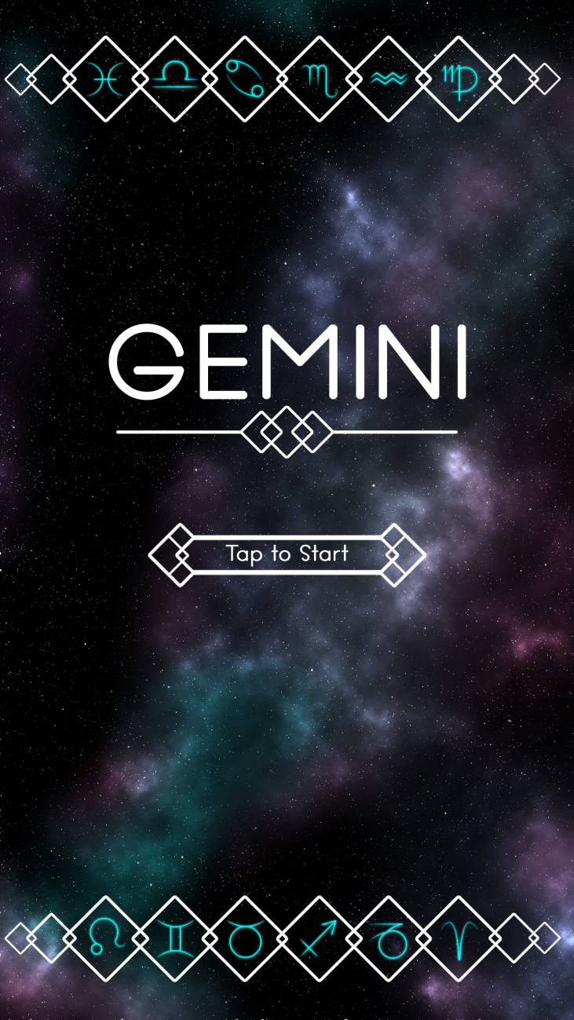
Our Brief
Mobile Platform
Potential for monetisation
Inclusion of smart depth
CW

Slide 3
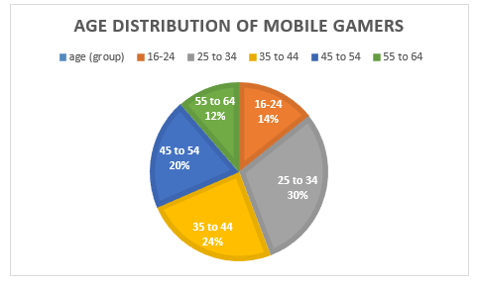
Demographic
Age: 25-44
Gender: Female
Source: http://www.realitymine.com/myth-busting-mobile-gaming-demographics/
JM

Slide 4
Psychographic
Emily
Favourite colour: Purple
Enjoys her own casual style
Enjoys shopping and reading in her spare time
Enjoys matching games
Times she spends each day on games: 2 hrs
Enjoys using social networks in the evening when she gets home to connect with her family and friends
JM

Slide 5


Platform and Genre
Platform: Mobile and Tablet
Genre: Hex based Puzzle
Duration: Up to 5 minutes
CJ

Slide 6

Game goal and Features
Creating an unbroken chain of hexes
Optimisation game
Hard Fun:
Accomplishment
Strategy
Clear Goal
CJ

Slide 7
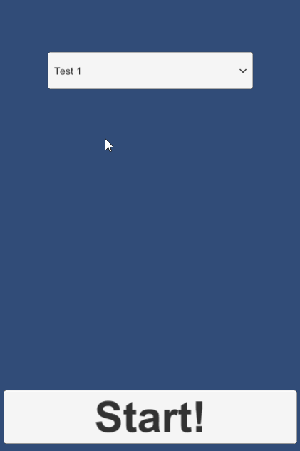
The Game Loop
Level start
Move tiles
Complete level
Earn rewards
JM

Slide 8
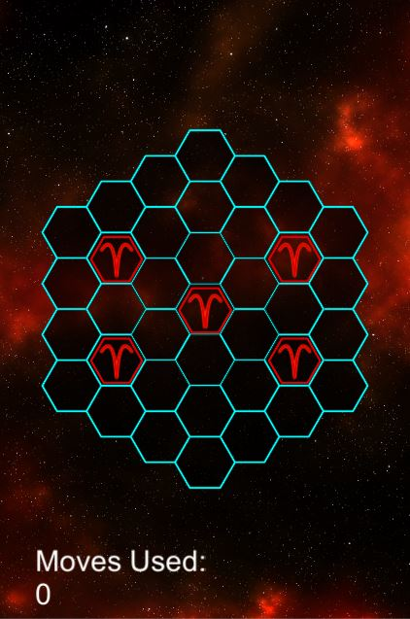
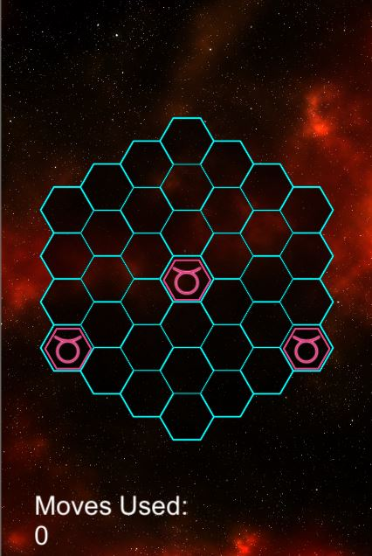
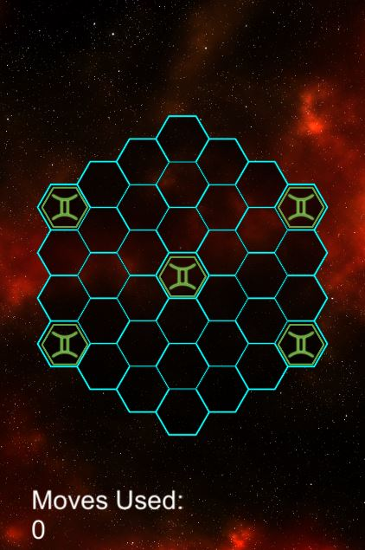
Prototype Levels
Aries
Taurus
Gemini
JM

Slide 9
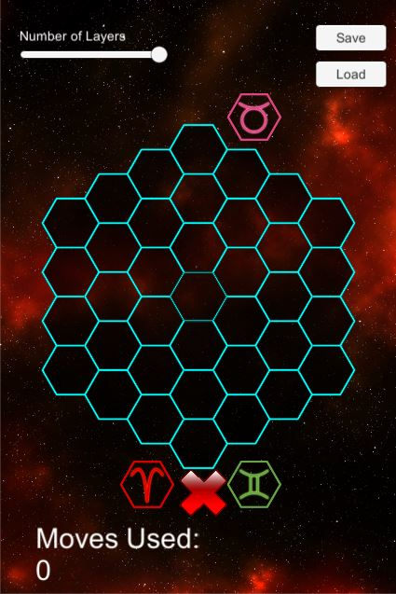
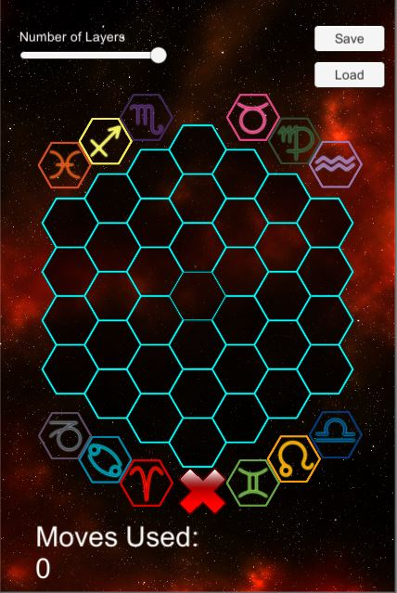
Level Editor
CJ

Slide 10
Tile Mechanics
Rotate the tiles around it clockwise and anti-clockwise
Symmetrical movement/mirrored
Horizontal/vertical/diagonal movement
Edge of hex movement
CW

Slide 11
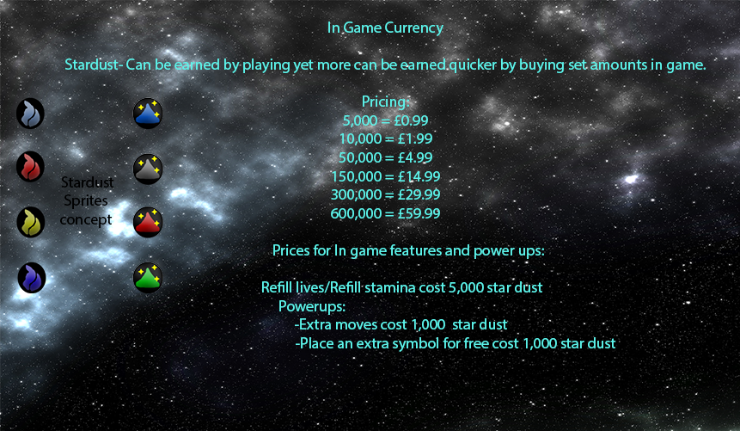
Currency & Power Ups
JM
JM

Slide 12
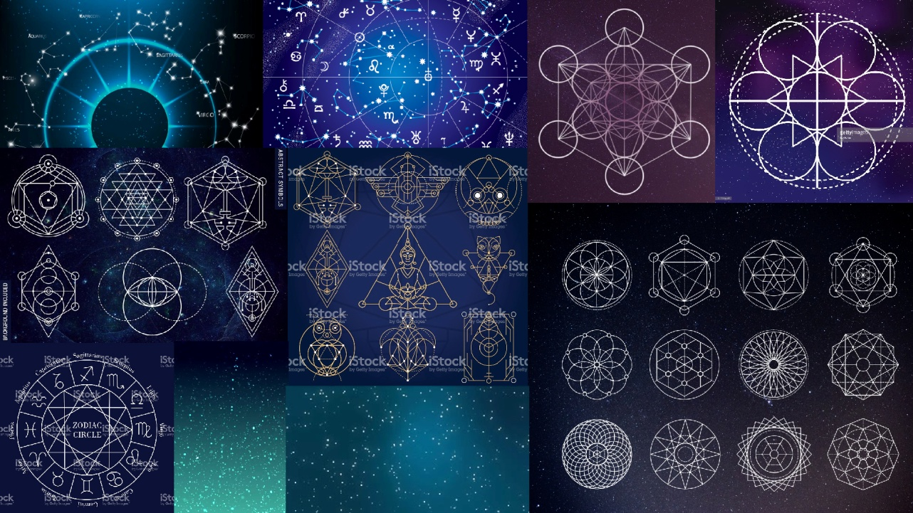
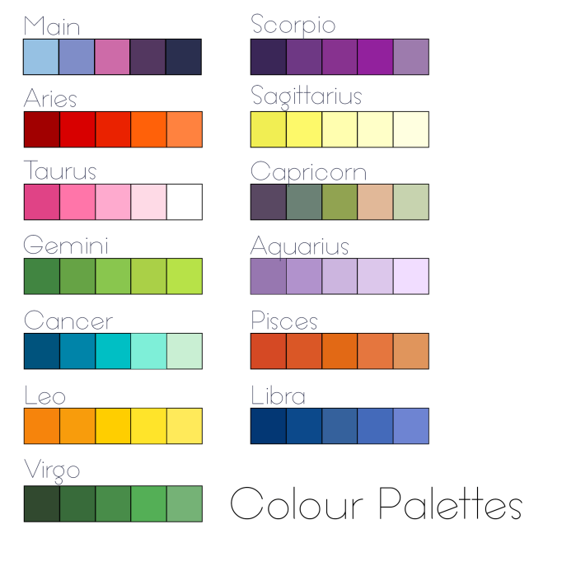
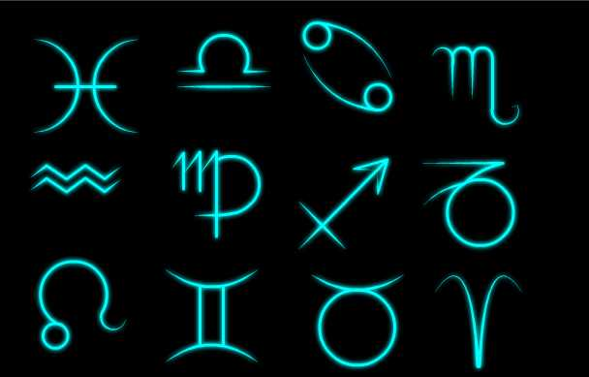

Artwork
CW

Slide 13
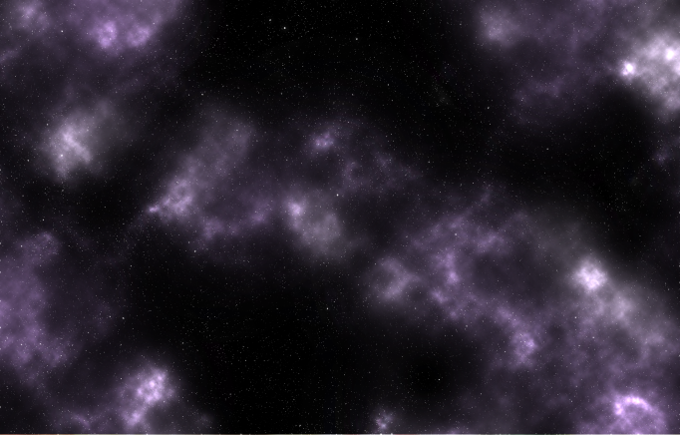
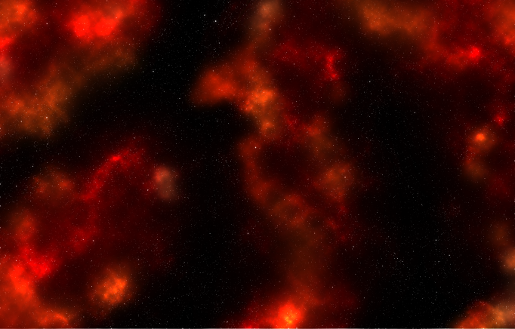

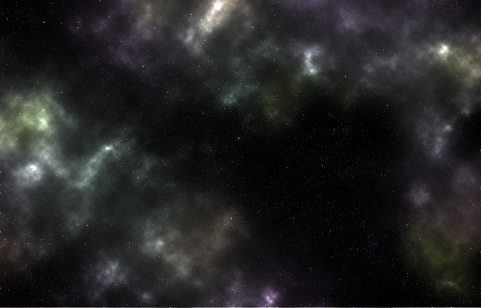
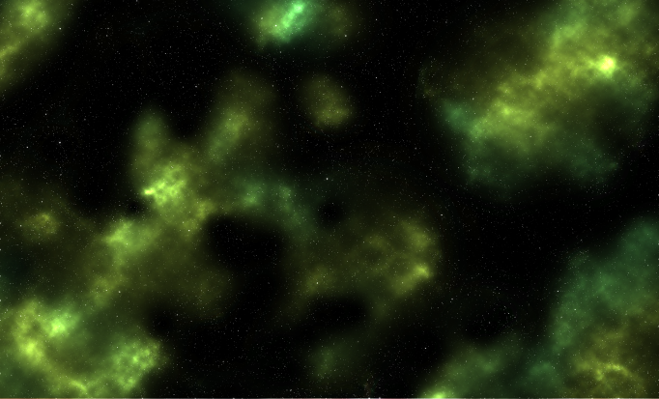
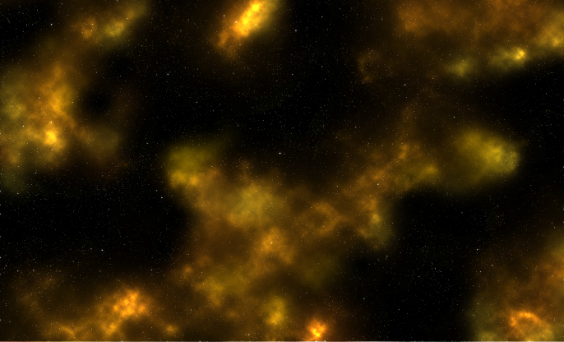
Artwork
CW

Slide 14
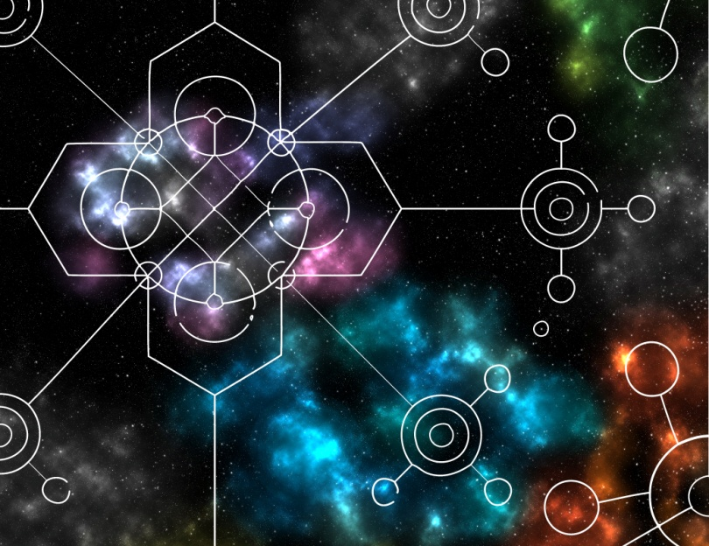
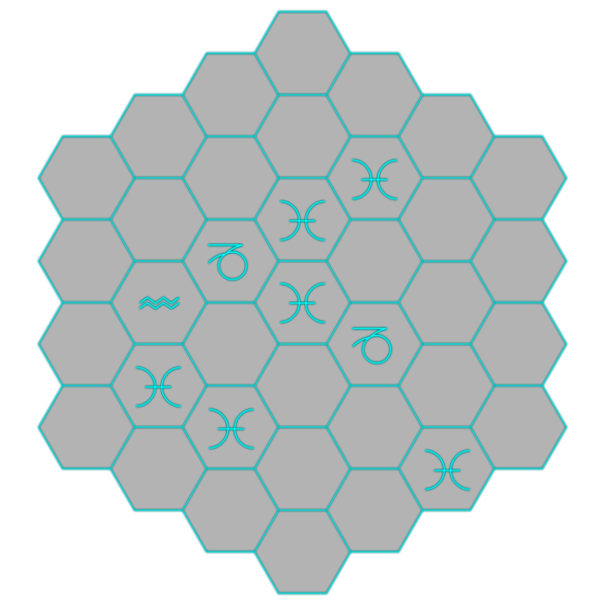
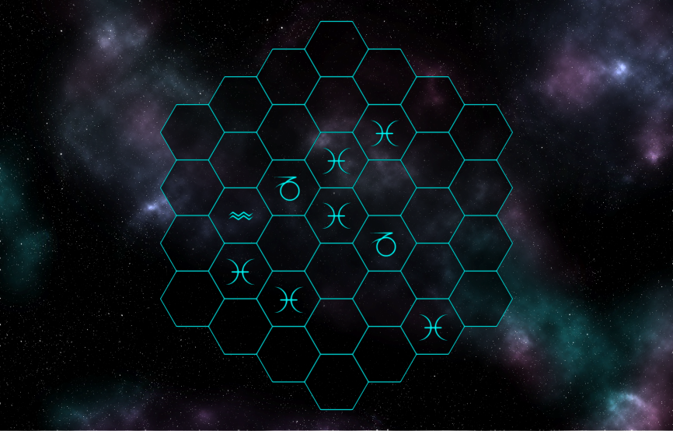
Artwork
CW

Slide 15
Playtesting & Usability Testing
Positive
Liked theme
Hex grid size sufficient
Negatives
Unclear what to do initially
No visual cue for completed level
JM

Slide 16
Strengths
Mechanics – easy to understand but hard to master
Suitable theme for target audience
Easy to play – buttons are good size to tap
JM

Slide 17
Weaknesses
Unclear what to do at first glance
Multiple tile mechanics – takes time to implement
Balancing
JM

Slide 18
Moving forward...
Further playtesting
Finalisation of characters, narrative and currency
Implementation of other tile mechanics
Producing levels with the level editor
CJ

Slide 19
Questions?

